Slide 1







COMA TEAM
Practical and theoretical courses
TEAM MEMBERS
AHMED ANWER “team leader”.
MOHAMED GAD .
LOZAN SHADY .
AHMED EID .
AHMED GAD .

Slide 2

INTRODUCTION
Communication problems
Our project is a specialized web platform to train and qualify technical education graduates on energy skills (renewable and non-renewable) and provide job opportunities through partnerships with specialized companies
Future Energy Gateway

Slide 3
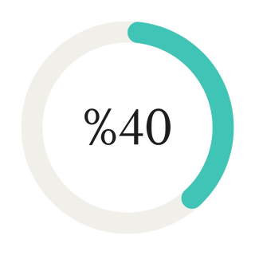
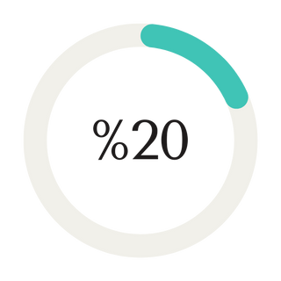
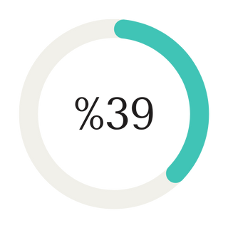
THE DATA
UNEMPLOYMENT
COMPANIES
TECHNICIANS

Slide 4


Internship
ONLINE
OFFLINE

Slide 5


PRACTICAL AND THEORETICAL COURSE
1st month
2nd month
3rd month
online session
Practical training in workshops.
Theoretical and practical tests

Slide 6



PRACTICAL AND THEORETICAL COURSE
4th month
5th month
6th month
Applied Projects
Use educational simulations.
Testing and qualification for work

Slide 7

FEATURES
Key ideas
Employment Opportunities
Expected Outcomes
Budget and Funding
Certification

Slide 8


FEATURES
Some key quote
Training Methods
Educational Resources
Students Distribution
Instructors Training
Evaluation and Monitoring

Slide 9
BUSINESS MODEL
Key
highlights
01
02
03
04
Add Value
Problem
Solution
Target Audience
Practical and theoretical courses, in addition to the possibility of employment and a certificate approved by specialized bodies
Unemployment
Environmental pollution
Energy cost
Awareness and training courses on the use of sustainable energy Training on how to use sustainable energy in most devices
Graduates, professionals in the field of electricity and mechanics, start-ups in the energy sector

Slide 10

FUTUER PLAN
DEVELOPMENT OF TRAINING CENTERS.
PARTNERSHIPS WITH INTERNATIONAL COMPANIES THAT OFFER INTERNATIONALLY ACCREDITED CERTIFICATES.
HELPING STUDENTS PRESENT THEMSELVES THROUGH ARTIFICIAL INTELLIGENCE
LAUNCHING THE MOBILE APP TO FOLLOW UP ON PERFORMANCE AND LINK THEM TO COMPANIES DIRECTLY
EXPANSION OF TRAINING CURRICULA

Slide 11

THANK
YOU.
CONTACT US IF YOU ARE
INTERESTED in our project.

Slide 12
